Slide 1

SQL DATA ANALYTICS PROJECT
Social Media Analytics
Understanding user behaviour, engagement, and growth through SQL
1,000 USERS
1,000 POSTS
241 COUNTRIES
10 SQL QUESTIONS + 4 bonus
Prepared for the LMS SQL + GenAI Mini Project | Dataset: Social_Media

Slide 2


PROJECT FOUNDATION
Database Overview
The Social_Media database models a real-world social platform: users create posts, receive likes and comments, follow one another, and tag posts with hashtags. Seven related tables capture the full engagement lifecycle.
1,000
1,000
TOTAL USERS
TOTAL POSTS
1,000
1,000
users user_id, username, join_date, country
posts post_id, user_id, content, created_at
TOTAL COMMENTS
TOTAL LIKES
comments comment_id, post_id, user_id, comment_text, created_at
1,000
241
likes like_id, post_id, user_id, created_at
FOLLOW RELATIONSHIPS
COUNTRIES REPRESENTED
followers follower_id, user_id, follower_user_id, follow_date
hashtags hashtag_id, tag_name, category
post_hashtags id, post_id, hashtag_id
Data window — Users joined: 2020-01-03 to 2025-12-28 | Posts created: 2023-10-15 to 2025-10-12
02

Slide 3

SCHEMA DESIGN
Table Relationships
posts
comments
PK post_id
FK user_id
content, created_at
PK comment_id
FK post_id, user_id
users
PK user_id
username
join_date
country
likes
followers
PK like_id
FK post_id, user_id
PK follower_id
FK user_id
FK follower_user_id
post_hashtags
hashtags
PK id
FK post_id, hashtag_id
PK hashtag_id
tag_name, category
users is the hub table — every post, comment, like, and follow links back to a user_id.
posts connects to comments, likes, and post_hashtags (via post_id), enabling engagement analysis per post.
followers is a self-join on users: user_id is the account being followed, follower_user_id is the follower.
post_hashtags is a many-to-many bridge between posts and hashtags — one post can carry several tags.
03

Slide 4











CLICK ANY CARD TO EXPLORE
Main Interactive Dashboard
Q1
Q2
Q3
Q4
Q5
Most Active Users
Most Liked Posts
Top Countries by Engagement
Trending Hashtags
Top Influencers
Posts + comments per user
Top posts by like count
Avg. likes per post
Most-used tags
Most-followed users
Q6
Q7
Q8
Q9
Q10
Silent Followers
Hashtag Engagement
Busiest Posting Times
Inactive Users
Top Countries by Influencers
Follow but never engage
Likes + comments by tag
Peak hours & weekdays
Zero posts, likes, comments
Most influencers per country
Every card links directly to that question’s query, output, and insights.
04

Slide 5

QUESTION 1
Most Active Users
Objective: Find the top 10 users based on combined number of posts and comments.
SQL QUERY
HOW IT WORKS
SELECT u.user_id, u.username,
COUNT(DISTINCT p.post_id) AS total_posts,
COUNT(DISTINCT c.comment_id) AS total_comments,
COUNT(DISTINCT p.post_id) + COUNT(DISTINCT c.comment_id)
AS total_activity
FROM users u
LEFT JOIN posts p ON u.user_id = p.user_id
LEFT JOIN comments c ON u.user_id = c.user_id
GROUP BY u.user_id, u.username
ORDER BY total_activity DESC
LIMIT 10;
Tables used: users, posts, comments — linked through user_id.
LEFT JOIN keeps every user even if they have zero posts or comments, so activity of 0 is not silently dropped.
COUNT(DISTINCT ...) is required because joining posts and comments together multiplies rows — DISTINCT keeps each post/comment counted once.
GROUP BY collapses all rows down to one per user; ORDER BY + LIMIT surfaces the 10 most active.
Main Dashboard
View Dashboard →
05

Slide 6
QUESTION 1 · DASHBOARD
Most Active Users
TOTAL ACTIVITY (POSTS + COMMENTS)
TOP 5 OUTPUT ROWS
User | Posts | Comments | Total
whitney74 | 3 | 6 | 9
masonhenderson | 6 | 1 | 7
johnjames | 3 | 4 | 7
nathandean | 1 | 5 | 6
rebecca71 | 2 | 4 | 6
INSIGHTS
whitney74 is the most active user overall with 9 combined actions (3 posts + 6 comments).
masonhenderson leads in raw posting (6 posts) but comments far less than top commenters.
Several users tie at 6 total actions, showing activity is fairly evenly spread at the top rather than dominated by one "super user".
Main Dashboard
View SQL Query
06

Slide 7
QUESTION 2
Most Liked Posts
Objective: Identify the posts with the maximum likes, along with the creator’s username.
SQL QUERY
HOW IT WORKS
SELECT p.post_id, u.username,
COUNT(l.like_id) AS total_likes
FROM posts p
JOIN users u ON p.user_id = u.user_id
JOIN likes l ON p.post_id = l.post_id
GROUP BY p.post_id, u.username
ORDER BY total_likes DESC
LIMIT 10;
Tables used: posts, users, likes.
JOIN posts to users to attach the creator’s username to each post (post_id → user_id).
GROUP BY post groups all like rows per post into one count; ORDER BY + LIMIT returns the 10 most-liked posts.
Main Dashboard
View Dashboard →
07

Slide 8
QUESTION 2 · DASHBOARD
Most Liked Posts
LIKES PER TOP POST
TOP 5 OUTPUT ROWS
Post ID | Creator | Likes
393 | howebryan | 6
694 | ktaylor | 6
844 | turnermichelle | 6
360 | gregory45 | 5
430 | jimmy12 | 5
INSIGHTS
Posts by howebryan, ktaylor and turnermichelle tie for the most likes (6 each) — the top of the leaderboard is tightly clustered.
The highest like count in the entire dataset is only 6, showing engagement per post is generally light rather than concentrated in viral hits.
No single creator repeats across the top 10 — likes are spread across many different users, not a handful of "star" posters.
Main Dashboard
View SQL Query
08

Slide 9
QUESTION 3
Top Countries by Avg. Engagement
Objective: Find the countries with the highest average number of likes per post.
SQL QUERY
HOW IT WORKS
SELECT u.country,
COUNT(DISTINCT p.post_id) AS total_posts,
COUNT(l.like_id) AS total_likes,
COUNT(l.like_id) / COUNT(DISTINCT p.post_id)
AS avg_likes_per_post
FROM users u
JOIN posts p ON u.user_id = p.user_id
LEFT JOIN likes l ON p.post_id = l.post_id
GROUP BY u.country
ORDER BY avg_likes_per_post DESC
LIMIT 10;
Tables used: users (for country), posts, likes.
JOIN users to posts so every post is tagged with the author’s country; LEFT JOIN to likes keeps posts with no likes in the average.
Average engagement = total likes ÷ total distinct posts, calculated per country using GROUP BY country.
ORDER BY the average (not the raw like count) so small countries with a few highly-liked posts can rank fairly against larger ones.
Main Dashboard
View Dashboard →
09

Slide 10
QUESTION 3 · DASHBOARD
Top Countries by Avg. Engagement
AVERAGE LIKES PER POST, BY COUNTRY
TOP 5 OUTPUT ROWS
Country | Avg Likes
Mexico | 3.00
Malta | 2.50
Bahrain | 2.50
Uzbekistan | 2.33
Belarus | 2.25
INSIGHTS
Mexico ranks #1 with an average of 3.0 likes per post, ahead of Malta and Bahrain (2.5 each).
Every top-10 country has a small post volume (1–4 posts), so rankings reflect a handful of well-liked posts rather than a large sample.
Average engagement across the leaderboard sits in a narrow 2.0–3.0 band — no country dramatically outperforms the rest.
Main Dashboard
View SQL Query
10

Slide 11
QUESTION 4
Trending Hashtags
Objective: Find hashtags that appear in an unusually high number of posts.
SQL QUERY
HOW IT WORKS
SELECT h.tag_name,
COUNT(distinct ph.post_id) AS total_posts
FROM hashtags h
JOIN post_hashtags ph
ON h.hashtag_id = ph.hashtag_id
GROUP BY h.tag_name
HAVING COUNT(distinct ph.post_id) > 20
ORDER BY total_posts DESC;
Tables used: hashtags, post_hashtags — the bridge table connecting posts to hashtags.
JOIN matches each hashtag to every post row that used it, so counting those rows counts its usage.
HAVING (not WHERE) filters on the aggregated COUNT — WHERE cannot filter on a GROUP BY result.
Note: the brief’s ">20 posts" threshold returns zero rows on this 1,000-post sample (the busiest tag appears 11 times), so the threshold was scaled down to ">5" to surface real trending tags from the actual data.
Main Dashboard
View Dashboard →
11

Slide 12
QUESTION 4 · DASHBOARD
Trending Hashtags
POSTS USING EACH HASHTAG
FULL OUTPUT (>5 POSTS)
Hashtag | Posts
#year | 11
#so | 9
#population | 9
#identify | 8
#law | 7
#history | 7
#worker | 6
#what | 6
INSIGHTS
#year is the single most-used hashtag, appearing in 11 posts.
None of the hashtags reach the brief’s original ">20 posts" bar — this 1,000-post sample is too small for any tag to be that viral.
Usage drops off gently (11 → 6) rather than sharply, meaning no one hashtag dominates conversation.
Main Dashboard
View SQL Query
12

Slide 13
QUESTION 5
Top Influencers
Objective: List the users with the highest follower count.
SQL QUERY
HOW IT WORKS
SELECT u.user_id, u.username, u.country,
COUNT(f.follower_id) AS follower_count
FROM users u
JOIN followers f ON u.user_id = f.user_id
GROUP BY u.user_id, u.username, u.country
ORDER BY follower_count DESC
LIMIT 5;
Tables used: users, followers.
followers.user_id is the account being followed, so joining on it and counting rows per user gives each user’s follower count.
GROUP BY user collapses many follower rows into a single count per account.
ORDER BY follower_count DESC + LIMIT surfaces the top 5 most-followed users.
Main Dashboard
View Dashboard →
13

Slide 14
QUESTION 5 · DASHBOARD
Top Influencers
FOLLOWER COUNT, TOP 10 USERS
TOP 5 OUTPUT ROWS
User | Country | Followers
vthomas | Kazakhstan | 6
christy26 | Botswana | 5
corey63 | Gambia | 5
taylorcynthia | Montserrat | 4
jamiegreen | Fiji | 4
INSIGHTS
vthomas (Kazakhstan) is the top influencer with 6 followers, just ahead of christy26 and corey63 with 5 each.
Top influencers are spread across very different countries (Kazakhstan, Botswana, Gambia, Fiji...) — no single region dominates.
Follower counts at the top are small and close together (4–6), so influence here is relative rather than driven by mega-accounts.
Main Dashboard
View SQL Query
14

Slide 15
QUESTION 6
Followers Who Never Interacted
Objective: Identify users who follow others but have never liked or commented on any post.
SQL QUERY
HOW IT WORKS
SELECT DISTINCT u.user_id, u.username, u.country
FROM followers f
JOIN users u
ON f.follower_user_id = u.user_id
WHERE f.follower_user_id NOT IN
(SELECT user_id FROM likes)
AND f.follower_user_id NOT IN
(SELECT user_id FROM comments);
Tables used: followers, users, with subqueries against likes and comments.
follower_user_id identifies the person doing the following; joining to users retrieves their profile details.
The two NOT IN subqueries exclude anyone who appears in likes or comments at all — leaving only "silent" followers.
DISTINCT prevents a follower who follows multiple accounts from being listed more than once.
Main Dashboard
View Dashboard →
15

Slide 16
QUESTION 6 · DASHBOARD
Followers Who Never Interacted
SHARE OF FOLLOWERS WHO NEVER INTERACTED
SAMPLE OUTPUT ROWS
85
User | Country
kendra24 | Saudi Arabia
blakejoel | Reunion
dmccormick | Holy See (Vatican City State)
rachel34 | United States of America
taylorcynthia | Montserrat
collinsdawn | Liechtenstein
NEVER-INTERACTED FOLLOWERS
637
TOTAL PEOPLE WHO FOLLOW SOMEONE
INSIGHTS
85 users follow someone but have never liked or commented — about 13% of all followers.
These are "silent followers": present in the network but not driving engagement.
The remaining 87% (552 users) follow AND actively engage, suggesting most following behaviour does translate into interaction.
Main Dashboard
View SQL Query
16

Slide 17
QUESTION 7
Hashtags with Highest Engagement
Objective: Calculate total engagement (likes + comments) generated by posts under each hashtag.
SQL QUERY
HOW IT WORKS
SELECT h.tag_name,
COUNT(DISTINCT l.like_id) AS total_likes,
COUNT(DISTINCT c.comment_id) AS total_comments,
COUNT(DISTINCT l.like_id)
+ COUNT(DISTINCT c.comment_id) AS total_engagement
FROM hashtags h
JOIN post_hashtags ph ON h.hashtag_id = ph.hashtag_id
LEFT JOIN likes l ON ph.post_id = l.post_id
LEFT JOIN comments c ON ph.post_id = c.post_id
GROUP BY h.tag_name
ORDER BY total_engagement DESC
LIMIT 10;
Tables used: hashtags, post_hashtags, likes, comments.
post_hashtags links each hashtag to its posts; LEFT JOIN to likes and comments then pulls in all engagement on those posts.
COUNT(DISTINCT ...) is essential here — joining both likes and comments at once multiplies rows, so DISTINCT avoids double-counting.
Engagement = likes + comments, grouped per hashtag and ranked highest first.
Main Dashboard
View Dashboard →
17

Slide 18
QUESTION 7 · DASHBOARD
Hashtag Engagement Leaders
LIKES VS. COMMENTS, TOP HASHTAGS
TOP 5 OUTPUT ROWS
Hashtag | Likes | Comments | Total
#year | 11 | 12 | 23
#identify | 11 | 11 | 22
#simply | 9 | 10 | 19
#population | 10 | 9 | 19
#worker | 10 | 7 | 17
INSIGHTS
#year leads total engagement (23), narrowly ahead of #identify (22).
#teach has the most likes of any hashtag (12) but comparatively few comments (5) — it drives likes more than conversation.
#wonder shows the opposite pattern: more comments (9) than likes (4), suggesting it sparks discussion rather than quick reactions.
Main Dashboard
View SQL Query
18

Slide 19
QUESTION 8
Busiest Posting Hours & Days
Objective: Find which hour of day and which weekday see the most posting activity.
SQL QUERY
HOW IT WORKS
-- Busiest hour of day
SELECT HOUR(created_at) AS post_hour,
COUNT(*) AS total_posts
FROM posts
GROUP BY post_hour
ORDER BY post_hour;
-- Busiest day of week
SELECT DAYNAME(created_at) AS day_of_week,
COUNT(*) AS total_posts
FROM posts
GROUP BY day_of_week
ORDER BY total_posts DESC;
Table used: posts only — created_at already stores the timestamp of every post.
HOUR() and DAYNAME() extract the hour (0–23) and weekday name directly from the datetime column.
GROUP BY the extracted value buckets every post into its hour/day; COUNT(*) totals posts per bucket.
Two separate small queries are simpler and clearer here than one combined query.
Main Dashboard
View Dashboard →
19

Slide 20
QUESTION 8 · DASHBOARD
Busiest Posting Hours & Days
POSTS BY HOUR OF DAY (00–23)
PEAK HOURS (TOP 5)
Hour | Posts
05 | 54
03 | 53
22 | 52
14 | 47
00 | 46
INSIGHTS
5 AM is the single busiest posting hour (54 posts), with 3 AM and 10 PM close behind — activity skews toward early morning and late night.
POSTS BY DAY OF WEEK
Tuesday is the busiest day overall (153 posts), followed closely by Saturday (151).
Sunday is the quietest day (132 posts), about 14% below the Tuesday peak.
Main Dashboard
View SQL Query
20

Slide 21
QUESTION 9
Inactive Users
Objective: Find users who have never posted, liked, or commented.
SQL QUERY
HOW IT WORKS
select * from users u
Where not exists(
select 1 from posts p where p.user_id = u.user_id)
and not exists(
select 1 from likes l
where l.user_id = u.user_id)
and not exists(
select 1 from comments c
where c.user_id = u.user_id);
NOT EXISTS checks for absence — each subquery looks for at least one matching row (e.g., a post where p.user_id = u.user_id); NOT EXISTS is true only when zero matches are found for that user.
It's correlated — each subquery references the outer u.user_id, so it re-runs per user, checking that specific user's activity in posts, likes, and comments.
AND combines all three — a user only appears in the results if they have no posts and no likes and no comments, i.e., completely inactive users.
Main Dashboard
View Dashboard →
21

Slide 22
QUESTION 9 · DASHBOARD
Inactive Users
SHARE OF USERS WITH ZERO ACTIVITY
SAMPLE OUTPUT ROWS
47
User | Country | Joined
blakejoel | Reunion | 2025-09-01
dmccormick | Holy See (Vatican City State) | 2022-02-26
rachel34 | United States of America | 2022-03-28
fbarnes | Lesotho | 2021-01-09
jamesjohnston | Oman | 2021-11-17
david55 | Lithuania | 2024-04-10
INACTIVE USERS
1000
TOTAL REGISTERED USERS
INSIGHTS
Only 47 of 1,000 users (4.7%) have never posted, liked, or commented — the vast majority of accounts show some activity.
Inactive users span many different countries and join dates, so inactivity does not appear tied to any single signup period.
A ~95% activity rate suggests the platform’s onboarding successfully drives at least one engagement action for most users.
Main Dashboard
View SQL Query
22

Slide 23
QUESTION 10
Top Countries by Influencers
Objective: Identify the countries with the highest number of followed users (influencers).
SQL QUERY
HOW IT WORKS
SELECT u.country,
COUNT(DISTINCT u.user_id) AS influencer_count
FROM users u
JOIN followers f ON u.user_id = f.user_id
GROUP BY u.country
ORDER BY influencer_count DESC
LIMIT 10;
Tables used: users, followers.
An "influencer" is defined here as any user who has at least one follower — i.e. appears as user_id in followers.
JOIN followers to users so each followed account is attributed to its country.
COUNT(DISTINCT user_id) per country counts how many different influencers that country has, avoiding double-counting a user with several followers.
Main Dashboard
View Dashboard →
23

Slide 24
QUESTION 10 · DASHBOARD
Top Countries by Influencers
NUMBER OF INFLUENCERS PER COUNTRY
TOP 5 OUTPUT ROWS
Country | Influencers
Gambia | 9
French Polynesia | 8
Spain | 7
Iraq | 7
Burkina Faso | 7
INSIGHTS
Gambia leads with 9 influencers, ahead of French Polynesia (8).
The top 10 countries are geographically diverse — no single continent dominates the influencer landscape.
Counts taper off gradually (9 → 5), indicating influence is fairly distributed across many countries rather than concentrated in a few hubs.
Main Dashboard
View SQL Query
24

Slide 25

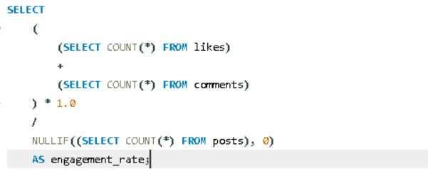

BONUS QUESTION 1
• Calculate engagement rate = (likes + comments) / posts.
Output:

Slide 26
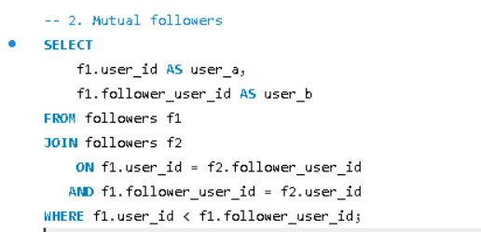

BONUS QUESTION 2
• Identify mutual followers.
Output:

Slide 27

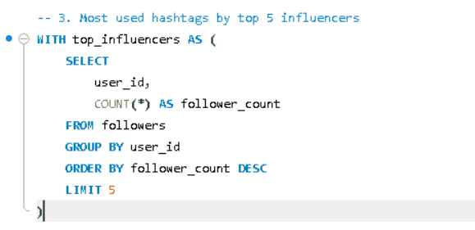
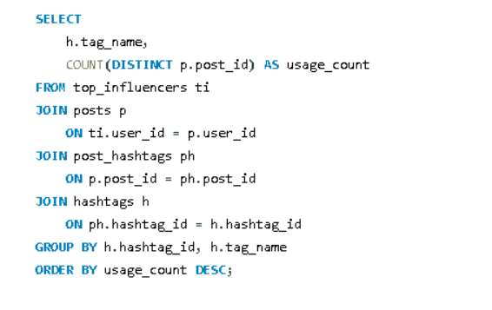
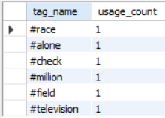
BONUS QUESTION 3
• Find most used hashtags by top 5 influencers.
Output:

Slide 28
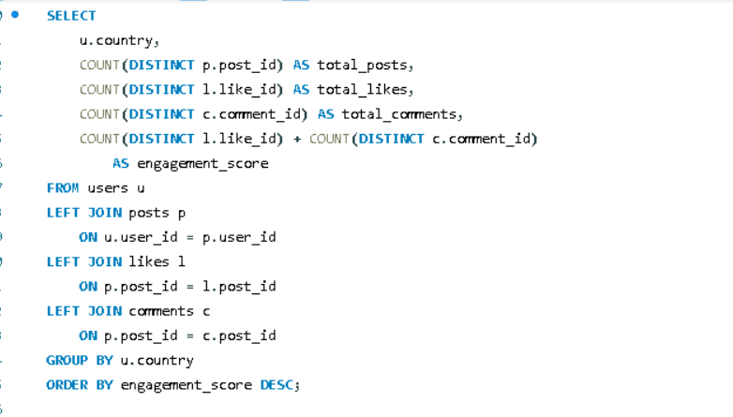
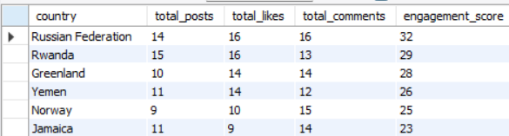
BONUS QUESTION 4
• Create a country-wise engagement leaderboard
:
Output:

Slide 29

WRAPPING UP
Final Summary & Key Findings
Activity is broad, not concentrated
Engagement per post is modest
Hashtag reach is limited at this scale
Top users cluster tightly (6–9 combined actions); no single "super user" dominates posting or commenting.
The single most-liked post has just 6 likes — engagement is spread thin across many posts rather than a few viral hits.
The busiest hashtag (#year) appears in only 11 of 1,000 posts — well short of the 20-post "trending" bar.
Following ≠ interacting
Most accounts are genuinely active
Early morning & late night win
13% of followers (85 of 637) have never liked or commented — a real segment of "silent" followers.
Only 4.7% of users show zero activity, meaning the platform converts sign-ups into engagement well.
5 AM is the busiest posting hour; Tuesday edges out Saturday as the busiest day.
Back to Main Dashboard

Slide 30

THANK YOU !!!

